Slide 1
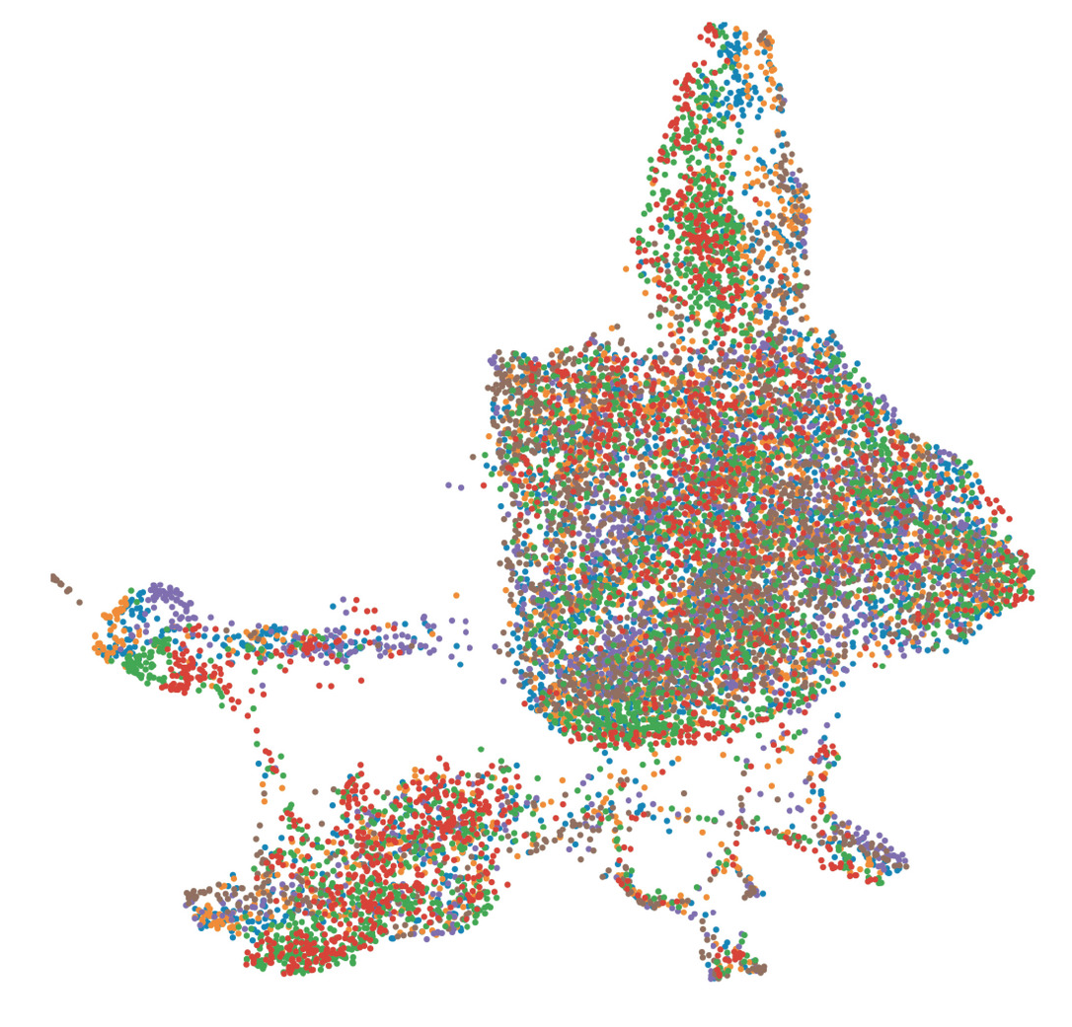
Quantitative Methods in Genetic and Genomics Single Cell Module
Rob Morey
Adapted from
Alex Chaim and Lior Pachter
February 1st, 2022

Slide 2
Module Overview
Day 1:
Single cell RNA-seq methods/biochemistry (lecture)
Break
Analysis methods and options (lecture)
Day 2:
Data analysis using Liu et al., "Reprogramming roadmap reveals route to human induced trophoblast stem cells"; Nature 2020

Slide 3
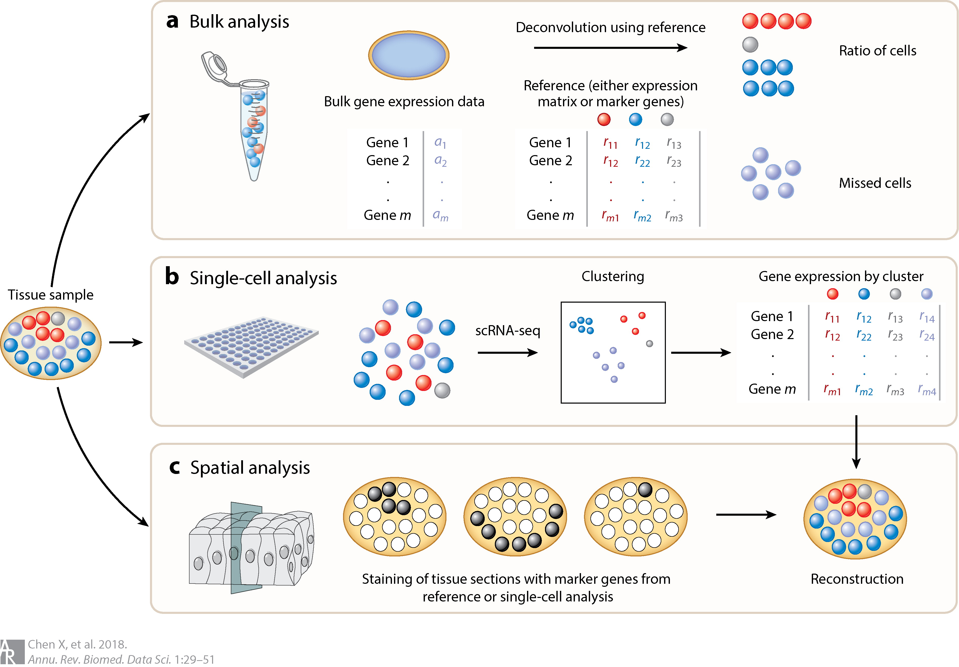
Why single cell transcriptomics?
Microarrays and bulk RNA sequencing mask the true distribution of gene expression levels across cells.
Notes:
Any given tissue of cell type expresses 11,000 to 13,000 genes, of which 3000 to 5000 have a cell-type specific expression pattern and the rest of the genes are ubiquitously expressed.

Slide 4
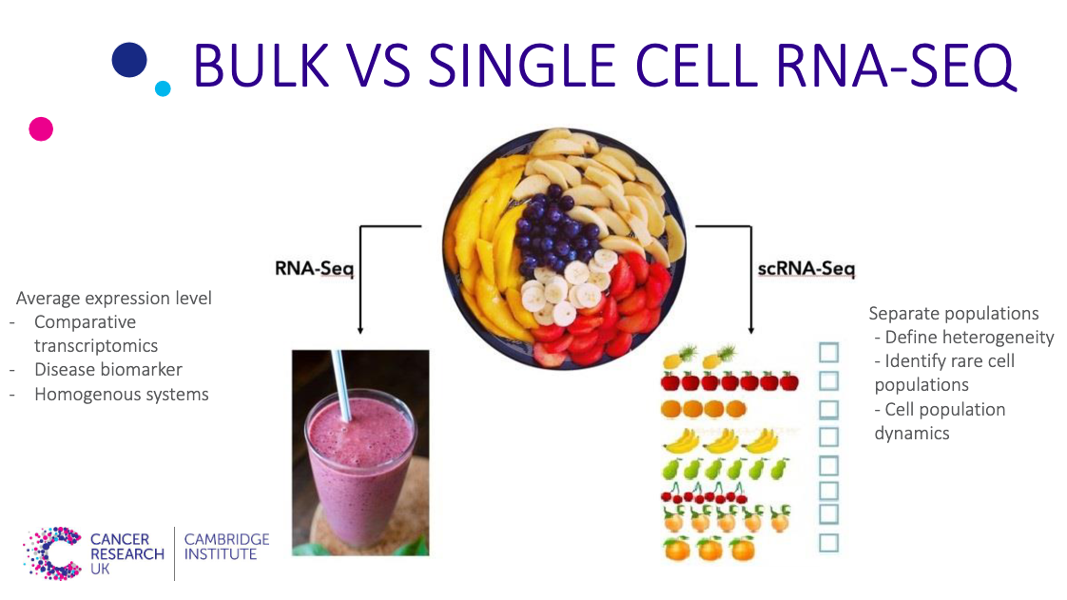

Slide 5
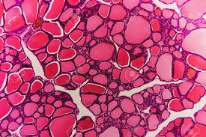
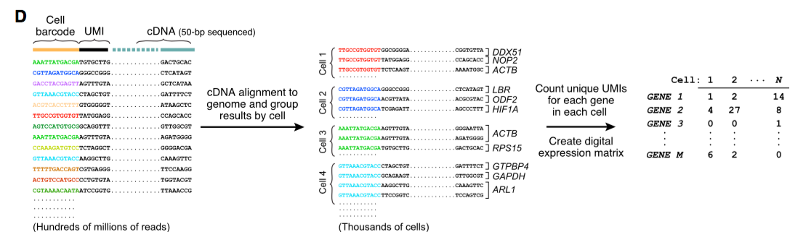
How do we go from cell to count matrix?

Slide 6
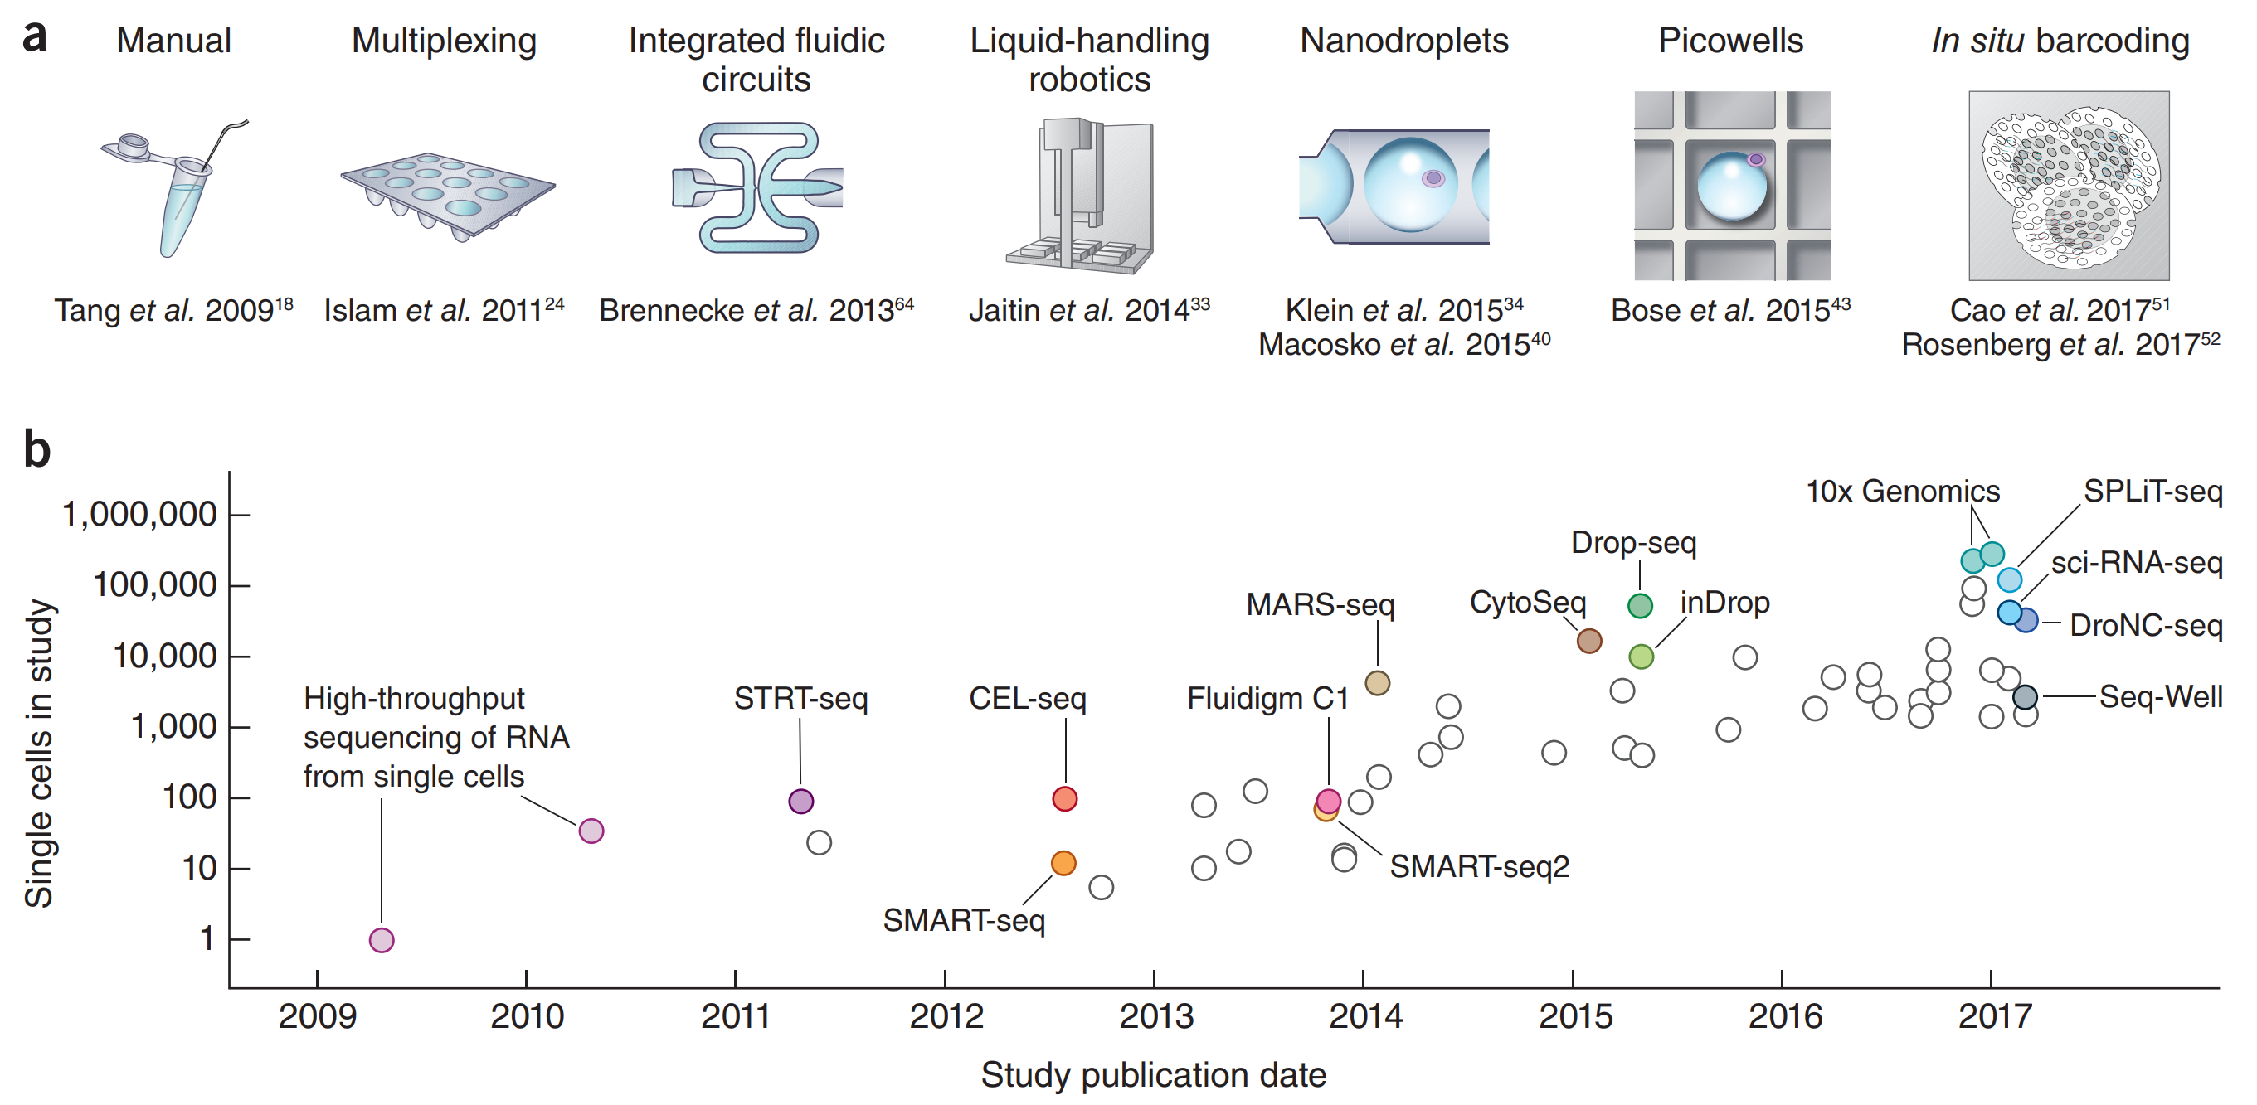
A decade of single-cell RNA-seq
Svensson et al. 2018. DOI:10.1038/nprot.2017.149

Slide 7
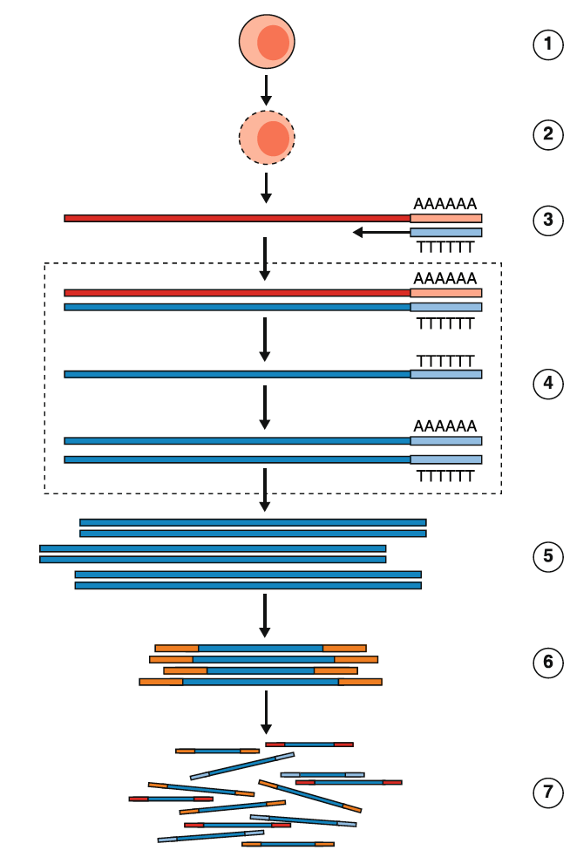
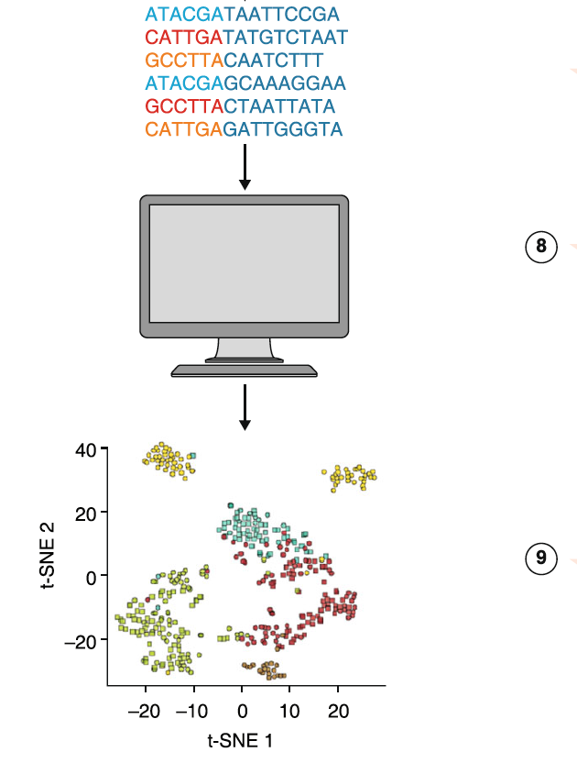
General workflow of a single cell (sc) RNA-Seq experiment
Critical Steps
Cell Isolation (cell or nuclei)
Cell lysis
mRNA capture
Cell Barcoding
Second Strand Generation
Analysis
cDNA amplification
Library Construction
Pool and sequence
Haque et al., 2017 Genome Medicine

Slide 8
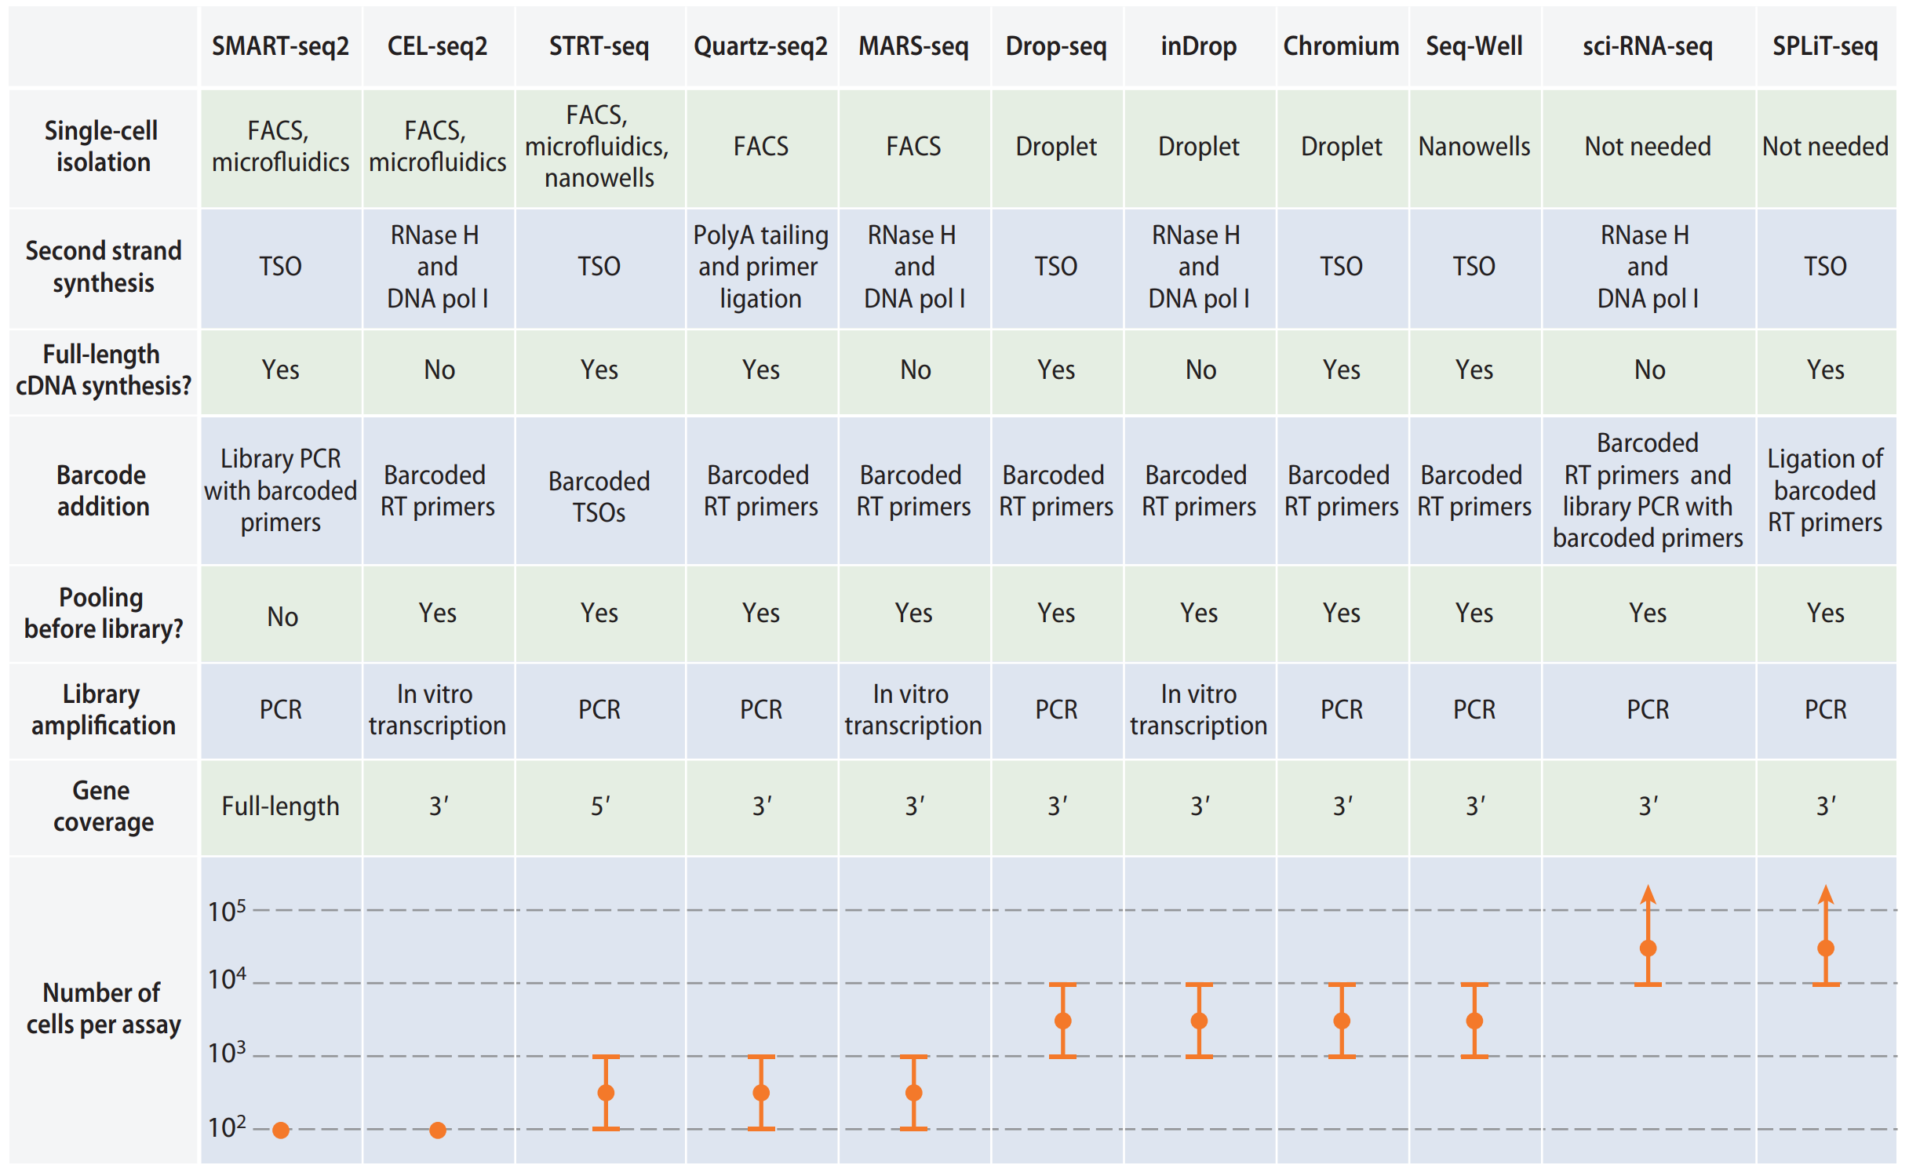
Popular single-cell RNA-seq protocols
Chen et al. 2018. DOI:10.1146/annurev-biodatasci-080917-013452

Slide 9
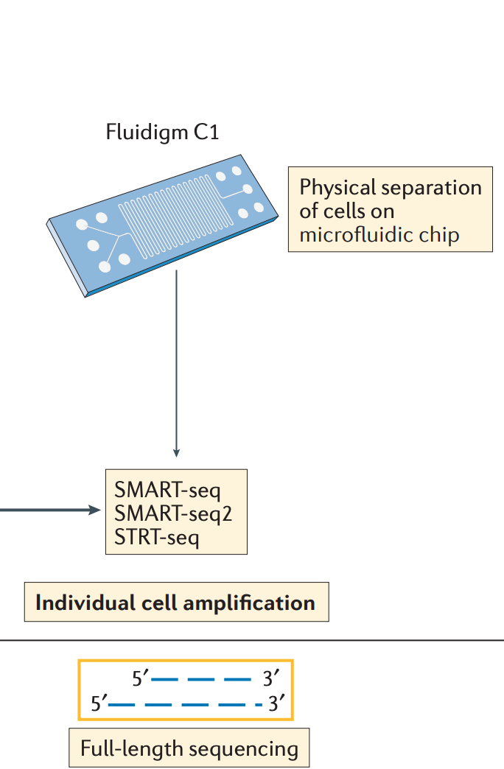
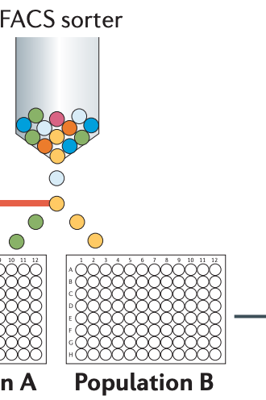
Droplet vs. Physical Physical separation of cells in wells
Papalexi and Satija, 2017. DOI:10.1038/nri.2017.76

Slide 10
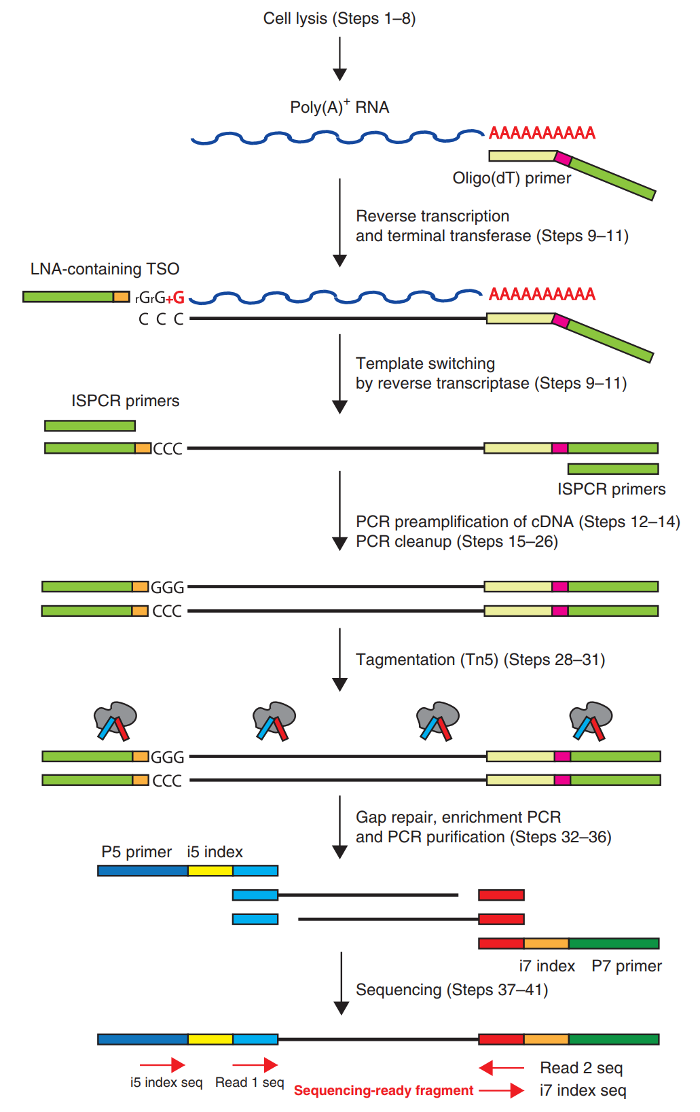
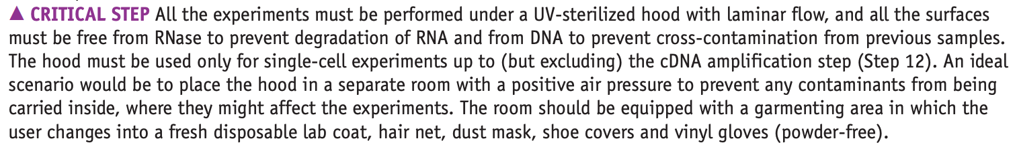
Example: library preparation for SMART-Seq2
Picelli et al., 2014. DOI:10.1038/nri.2017.76

Slide 11
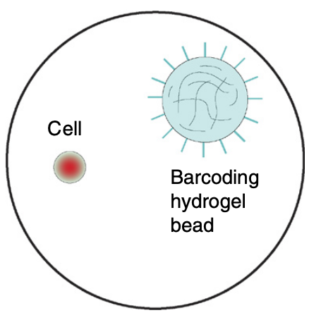
Droplet vs. Physical Microfluidic methods: Beads, Cells and Droplets
Zilionis et al. 2016. DOI:10.1038/nprot.2016.154

Slide 12
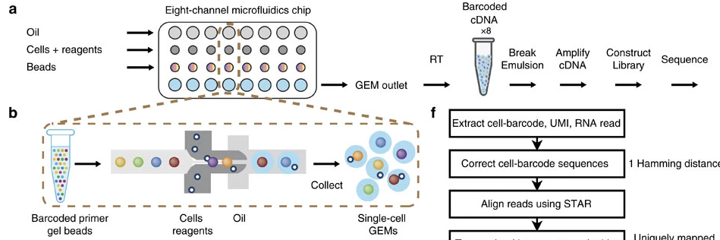
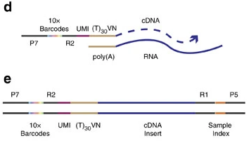
10X Genomics Overview
Zheng et al., 2017 Nature Communications​

Slide 13
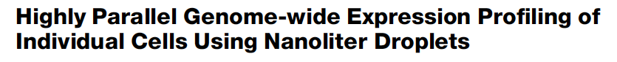
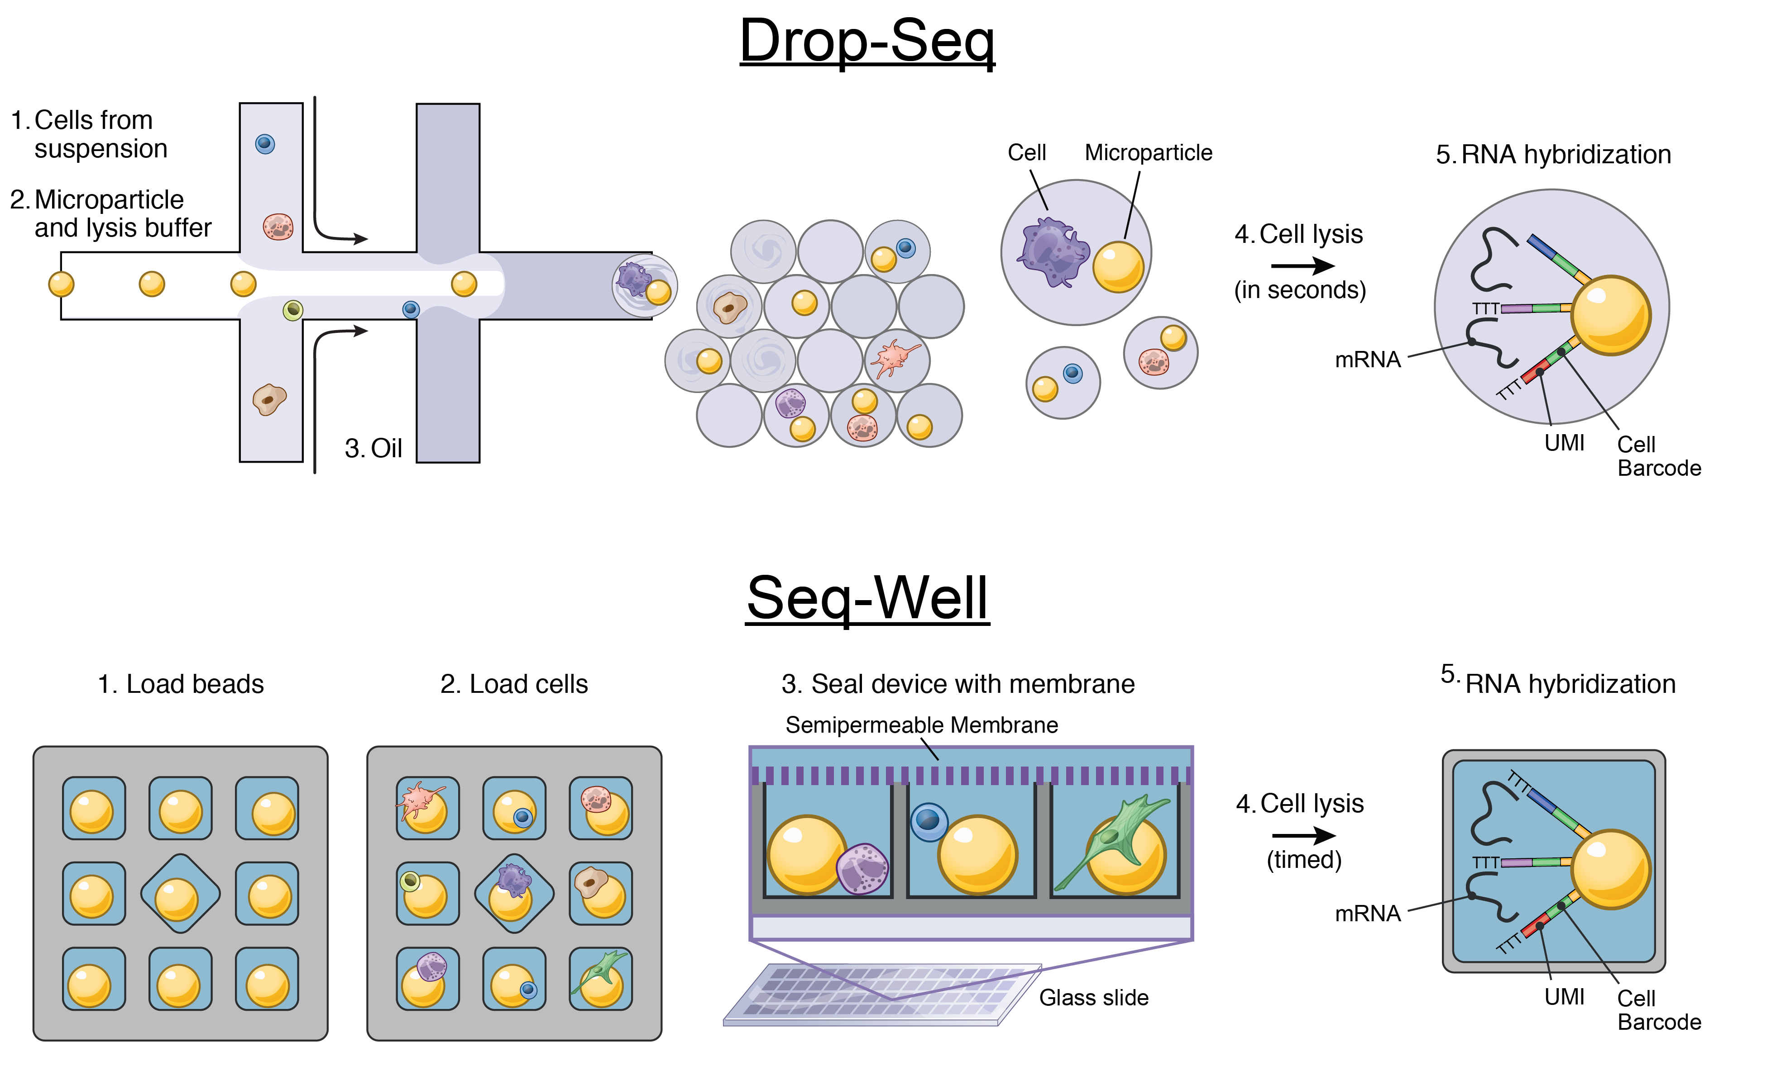
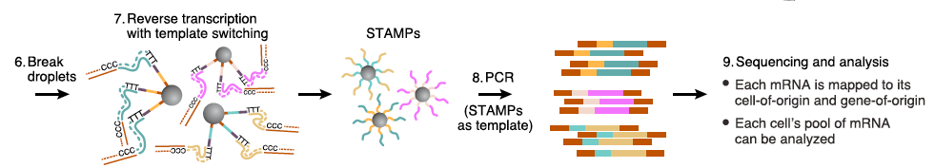
Drop-Seq
Macosko et al., 2015 Cell

Slide 14
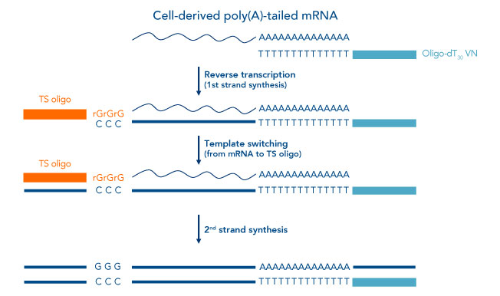
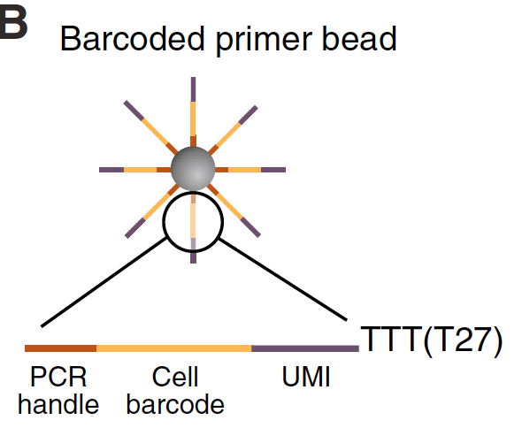
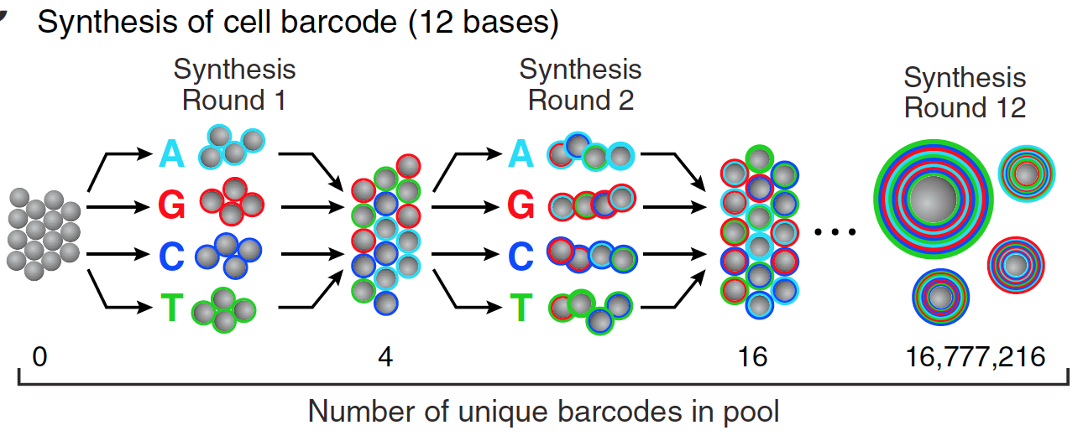
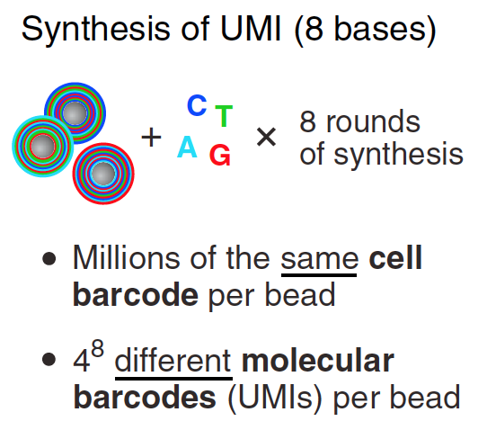
3’ end Capture Beads - UMIs and Bead Barcodes
UMI
BBC
PCR
4¹² = 16,777,216 barcodes
4⁸ = 65,536 UMIs
> 10⁶ oligos/bead
Macosko et al., 2015 Cell

Slide 15
Cell capture and duplication rates
The cell capture rate is the probability that a droplet has at least one bead = .
The cell duplication rate is the rate at which captured single cells are associated with two or more different barcodes, which is equal to .
This leads to a tradeoff:

Slide 16
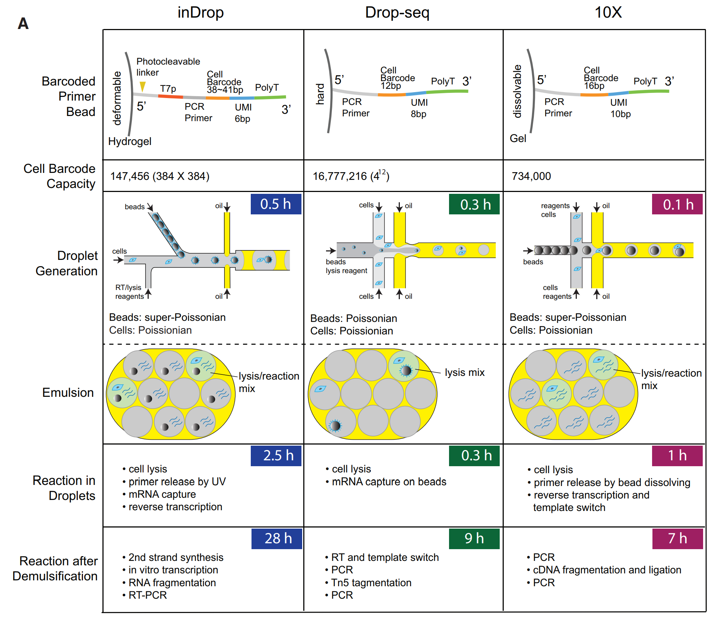
Summary of droplet technologies
Zhang et al. 2019. DOI:10.1016/j.molcel.2018.10.020

Slide 17
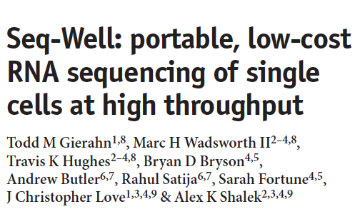
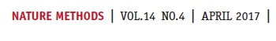
Seq-Well abrogates the need for droplet-based microfluidic devices

Slide 18
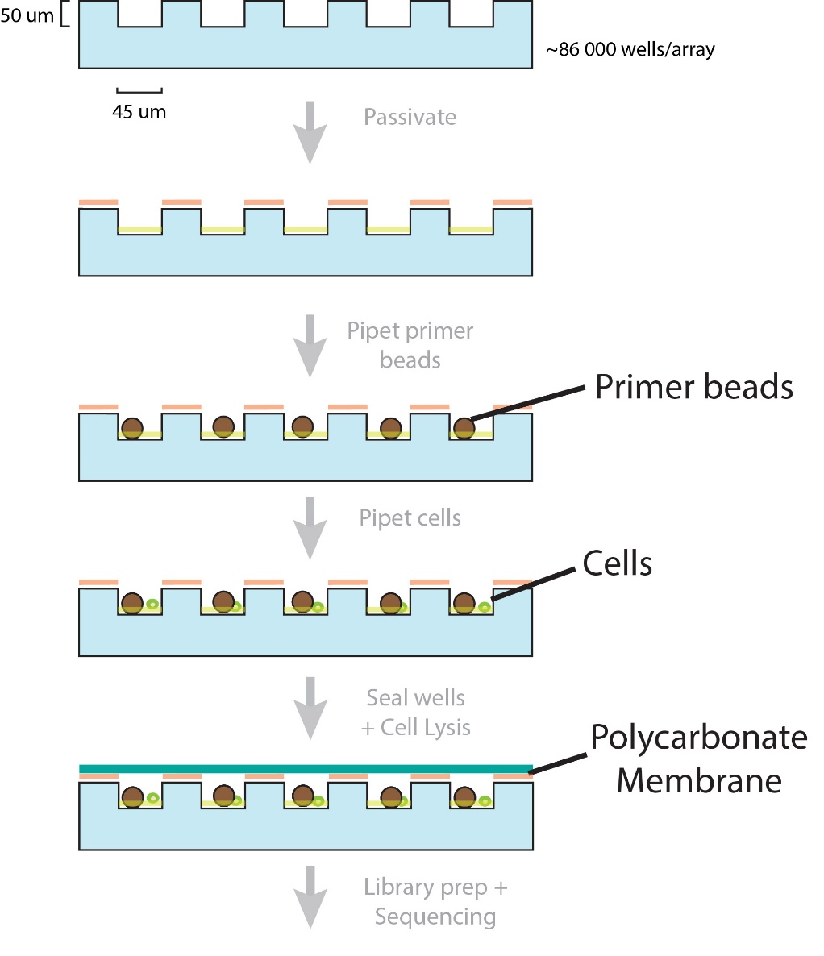
Seq-Well workflow in Images
Pre-wash
100 um
Post-wash + shake
100 um

Slide 19
Seq-Well workflow in Images
Pre-cell loading
100 um
Cell
Post-cell loading + shake
Bead
Capture rate > 50%
100 um

Slide 20
Common problems - Technical doublets
Technical doublets arise when two or more cells are captured in a droplet with a single bead. The technical doublet rate is therefore the probability of capturing two or more cells in a droplet given that at least one cell has been captured in a droplet:
Note that “overloading” a microfluidics single-cell experiment by loading more cells while keeping flow rates constant will increase the number of technical doublets due to an effective increase in and also the number of synthetic doublets due to a decrease in relative barcode diversity.

Slide 21
Doublet detection: the barnyard plot
Croset et al. 2018. DOI:10.7554/eLife.34550

Slide 22
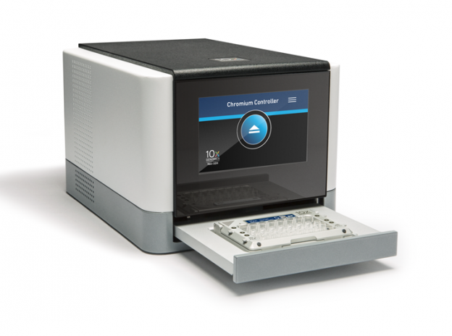
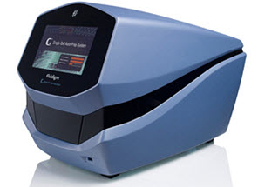
Which is better – full length or 3' end?

Slide 23
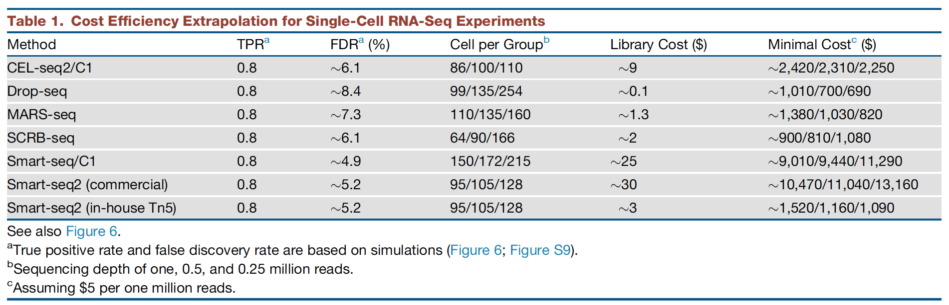
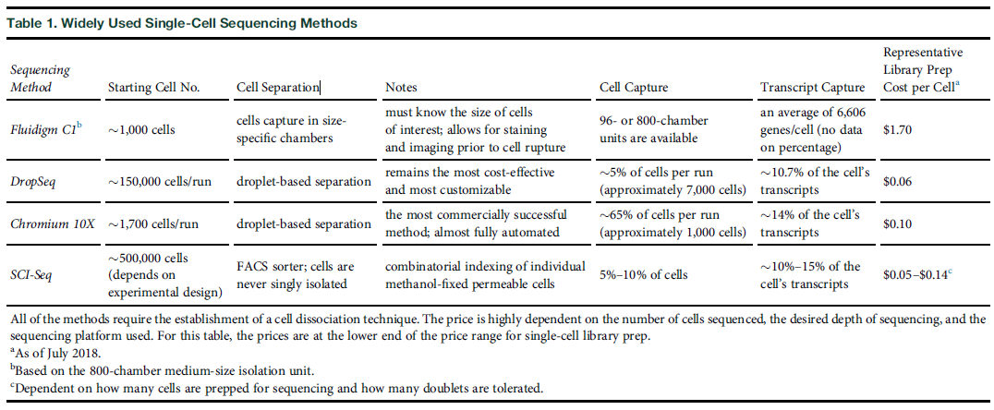
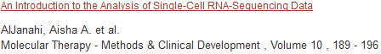
Single cell technologies (3’-end vs full-length)
Ziegenhain et al., 2017 Molecular Cell

Slide 24
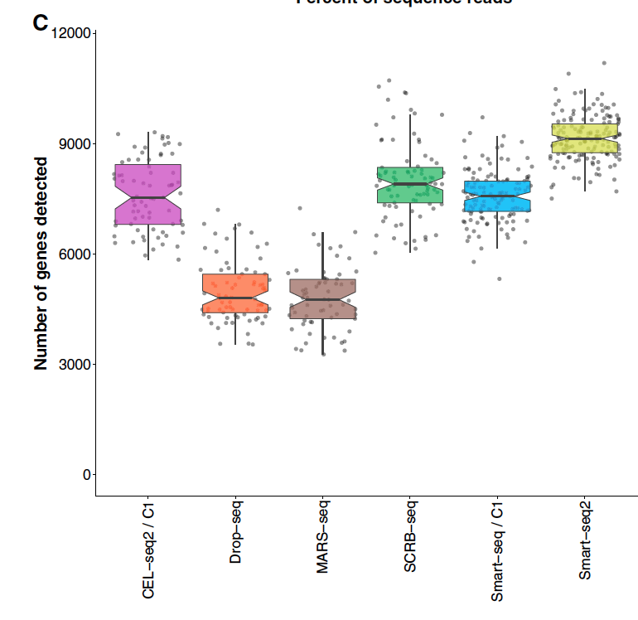
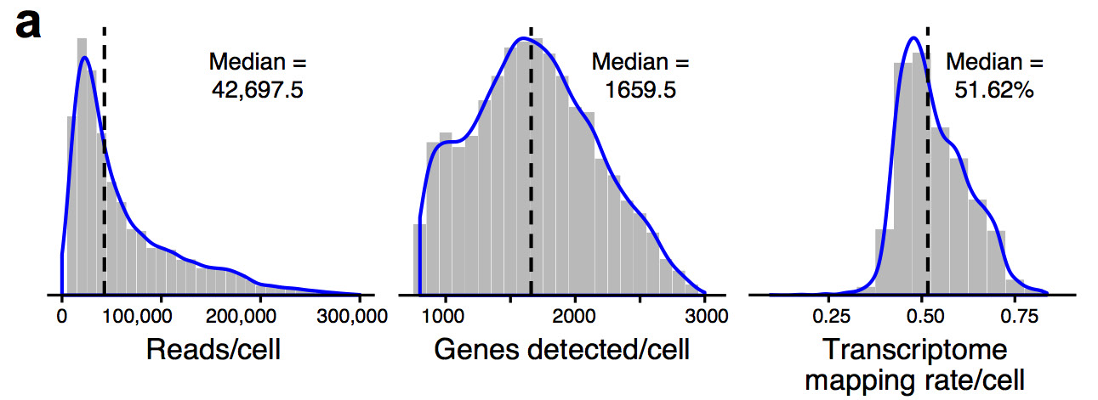
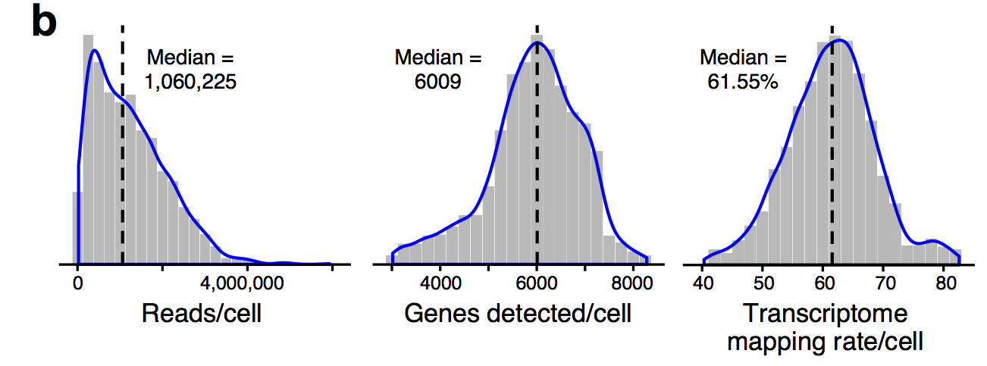
3’-end vs full-length Inter-platform comparison
10X
Smart-Seq2
Ziegenhain et al., 2017 Molecular Cell
Haber et al., 2017 Nature

Slide 25
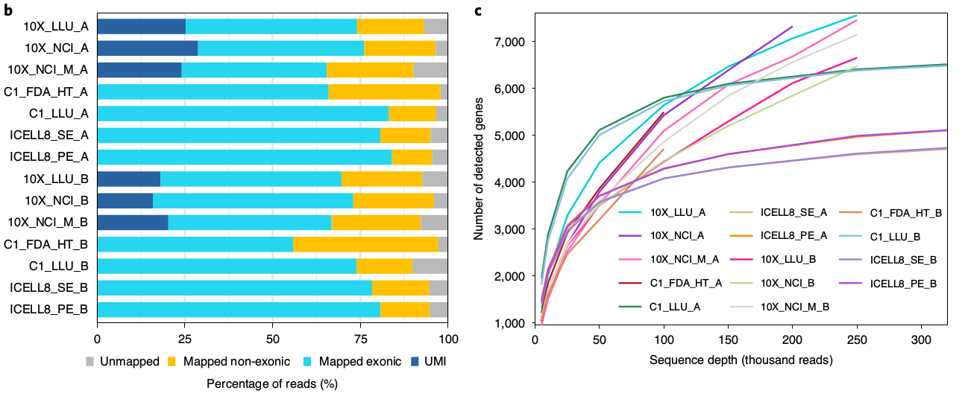
3’-end vs full-length Inter-platform comparison
*
*
*
*
*
*
"*" = Full-length
Chen et al., 2020 Nature Biotech

Slide 26
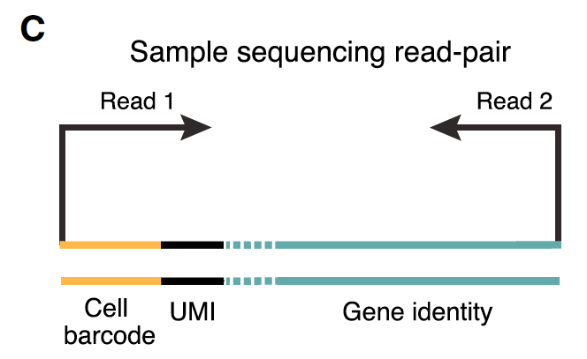
3’-end based technologies Post-sequencing

Slide 27
3’-end based technologies - Post-sequencing
Macosko et al., 2015 Cell

Slide 28

Break Time

